Slide 1

PROJECT STAGE I – (CD753PC) | VII SEM – CSD
AI-BASED SMART UNDERGROUND CABLE FAULT DETECTION AND REMOTE MONITORING
ESP32 • IoT • Machine Learning • Predictive Maintenance
Student | Roll Number | Name of Supervisor
Deta Jonah Ratan | 23261A6717 | Ms. A. Swapna Asst. Professor, Dept. of ET
Madavaram Vineel | 24265A6702
Pasnoori Abhinay | 24265A6704
Notes:
Introduce the project, the team and the supervisor.

Slide 2

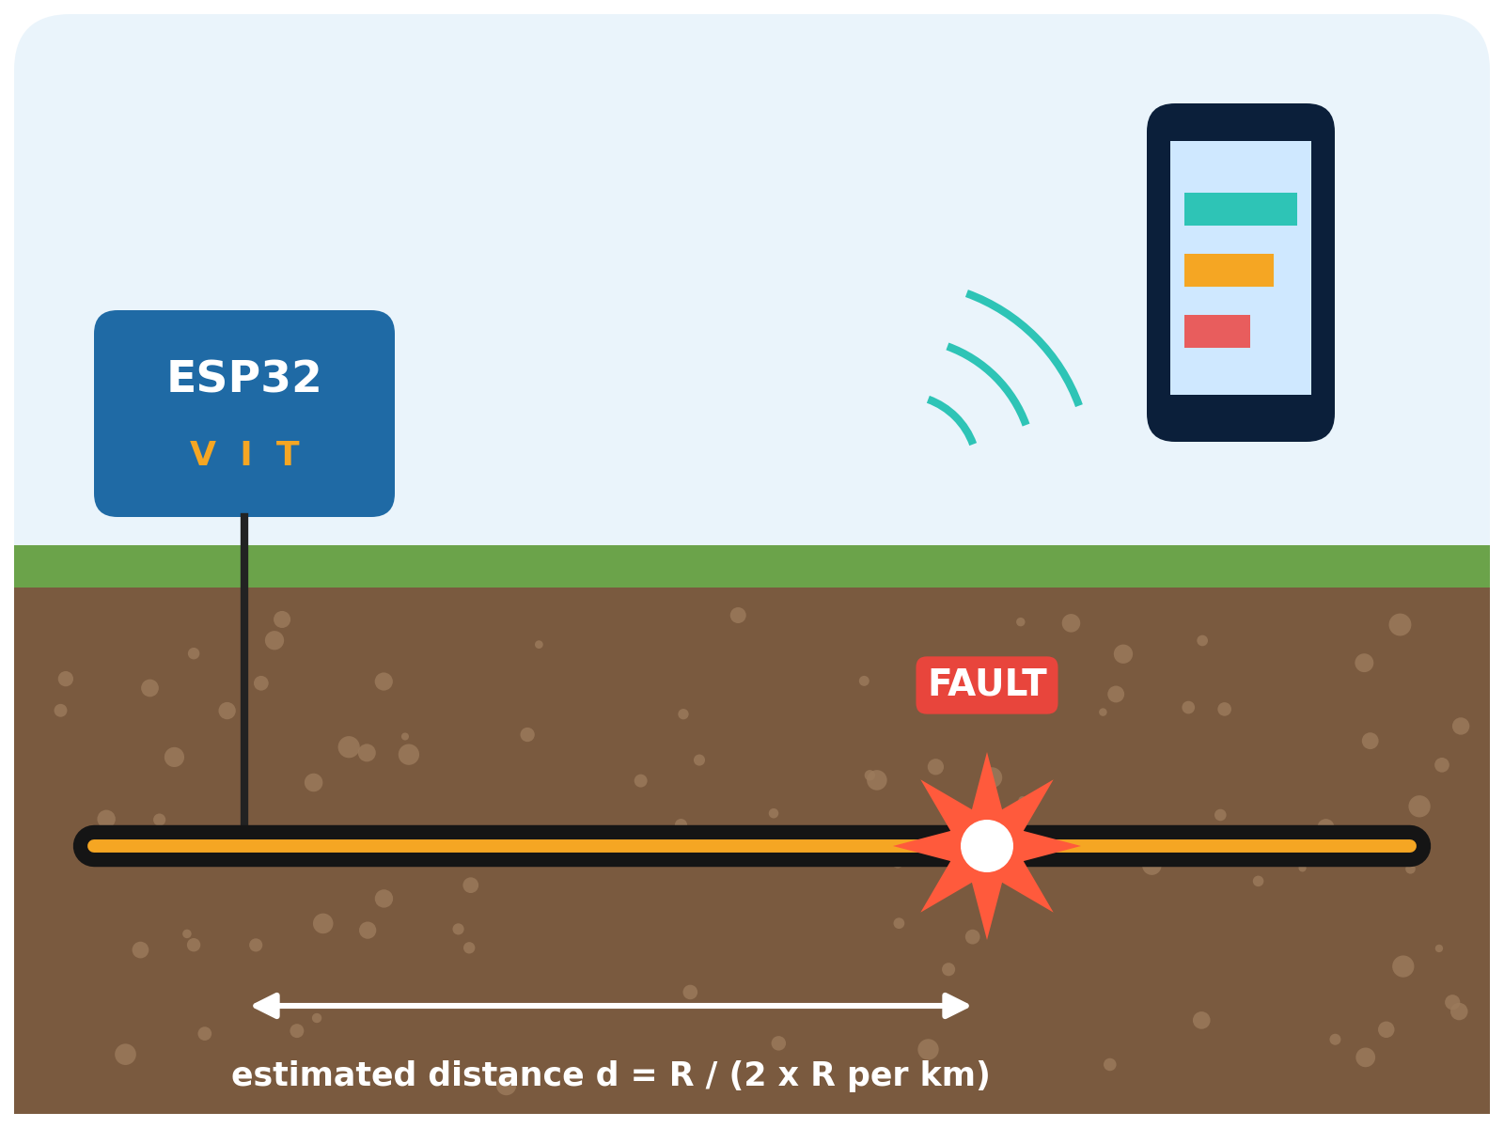
ABSTRACT
Underground cable faults are hard to locate because cables are buried; conventional methods need manual inspection and excavation.
An ESP32 monitors voltage, current and TMP117 temperature on a safe, current-limited cable simulator to detect open and short circuits.
The fault distance is estimated from calibrated measurements using Ohm's law; an OLED and buzzer give local alerts.
Data goes over Wi-Fi to an Android app, where an ML model diagnoses the cable condition and is compared with a baseline algorithm.
Logged trends give a cable health index for early warning and predictive maintenance.
ESP32 monitors the buried cable, locates the fault and reports it to the mobile app.
Notes:
Summarise the whole project.

Slide 3





INTRODUCTION
Underground cables give safe and reliable power distribution.
Being buried, their faults are difficult to detect and locate.
Many faults develop slowly as voltage drop, irregular current or joint heating.
Murray loop and TDR methods need costly equipment and skilled operators.
The proposed ESP32 system monitors voltage, current and temperature continuously.
A mobile app with ML diagnosis supports early detection and predictive maintenance.
COMMON CABLE FAULTS
Open Circuit
Short Circuit
Conductor breaks; current stops
Low-resistance path; high current
Overcurrent
Overheating
Load beyond safe limit
Hot joints and loose terminations
Notes:
Background and motivation.

Slide 4





EXISTING SYSTEM
Faults are detected mainly after they occur.
Cables are not monitored continuously or remotely.
Loop tests and TDR instruments are costly and need experts.
Low-cost prototypes detect mostly short circuits using fixed thresholds.
Temperature and cable-health trends are not analysed.
Predictive maintenance capability is very limited.
IMPACT
Manual excavation
Long stretches dug to find one fault
Long outages
Slow location delays restoration
High repair cost
Labour, equipment and road damage
No early warning
Deterioration goes unnoticed
Notes:
Limitations of current practice.

Slide 5






PROBLEM STATEMENT & OBJECTIVES
Design a low-cost, safe and intelligent system that detects, locates and diagnoses underground cable faults, and warns of deterioration before failure.
Detect
Locate
Monitor
Classify open-circuit and short-circuit faults
Estimate fault distance from calibrated measurements
Track voltage, current and temperature continuously
Diagnose
Alert
Predict
Apply ML and compare with a baseline algorithm
Show live data and alerts on app, OLED and buzzer
Log events and analyse trends for maintenance
Notes:
Problem statement and six objectives.

Slide 6


REQUIREMENTS SPECIFICATION
Software
Hardware
Item | Specification
OS | Windows 10/11 or Ubuntu 20.04+
Firmware IDE | Arduino IDE / PlatformIO
App IDE | Android Studio
Languages | Embedded C/C++, Kotlin/Java, Python
ML | Scikit-learn, TensorFlow Lite
Protocol | Wi-Fi (MQTT / HTTP)
Database | SQLite / Firebase
Component | Specification
Controller | ESP32 (dual-core, Wi-Fi)
Voltage | Calibrated voltage dividers
Current | INA219 / ACS712
Temperature | TMP117 (I2C)
Display | OLED SSD1306 (I2C)
Alerts | Buzzer and status LEDs
Power | 5V / 12V DC, current-limited
Notes:
Software and hardware requirements.

Slide 7


PROPOSED SYSTEM & METHODOLOGY
Sensing & Fault Simulation
ESP32 Processing
Cable simulator with resistor sections
Fault switches for open / short circuits
Voltage, current and TMP117 sensors
Filtering and calibration
Baseline fault detection
Ohm's-law distance estimation
Communication & Local Alerts
Mobile App & ML
Wi-Fi using MQTT / HTTP
OLED display, buzzer and LEDs
Timestamped data packets
Background ML diagnosis (TFLite)
Dashboard, graphs and alerts
Event log and health index
Notes:
Four functional units.

Slide 8

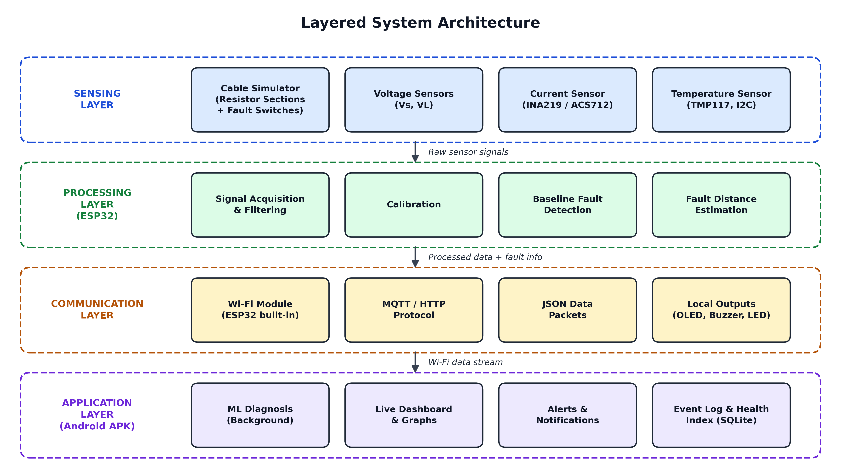
SYSTEM ARCHITECTURE
KEY POINTS
1
Sensing layer reads voltage, current and temperature from the cable simulator.
2
Processing layer on the ESP32 filters data, detects faults and estimates distance.
3
Communication layer sends data over Wi-Fi and drives the OLED, buzzer and LEDs.
4
Application layer runs ML diagnosis, the dashboard, alerts and the health index.
Notes:
Walk through the four layers from bottom to top.

Slide 9
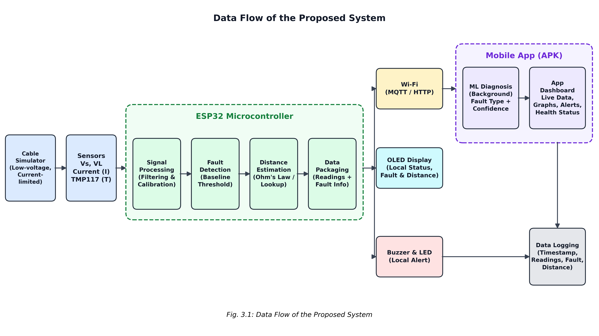
DATA FLOW
KEY POINTS
1
Cable simulator and sensors feed live readings to the ESP32.
2
ESP32 processes data, detects faults, estimates distance and packages results.
3
Outputs go to the app over Wi-Fi, and locally to the OLED, buzzer and LEDs.
4
The mobile app runs ML diagnosis and logs every reading and fault event.
Notes:
Follow the data from left to right.

Slide 10
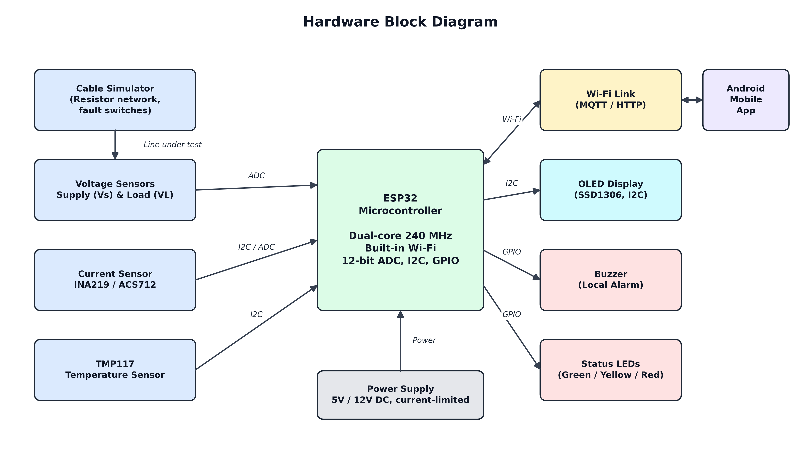
HARDWARE BLOCK DIAGRAM
KEY POINTS
1
ESP32 is the central controller with dual-core processing and built-in Wi-Fi.
2
Voltage sensors use the ADC; INA219 and TMP117 use the I2C bus.
3
OLED uses I2C, while the buzzer and status LEDs use GPIO pins.
4
A current-limited 5V / 12V supply powers the system and simulator.
Notes:
Explain each interface of the ESP32.

Slide 11
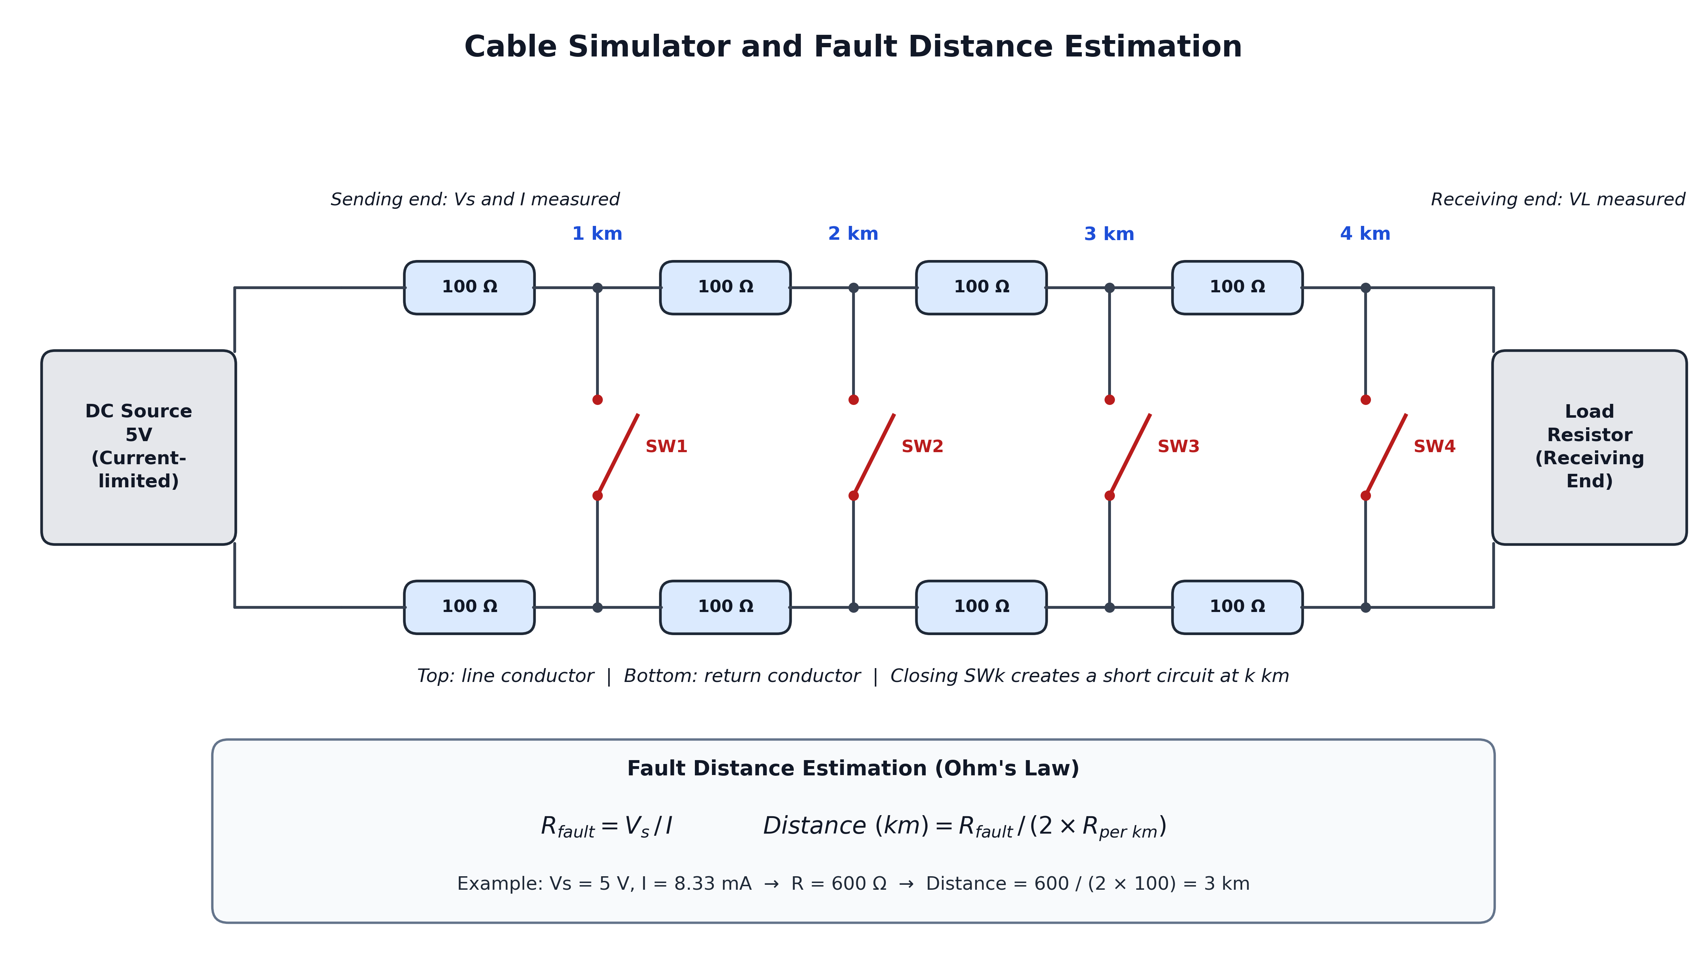
FAULT DISTANCE ESTIMATION
KEY POINTS
1
Each 1 km section is a 100 Ω resistor in both line and return conductors.
2
Closing switch SWk creates a short circuit at k km.
3
Loop resistance is measured as R = Vs / I at the sending end.
4
Distance = R / (2 × R per km); e.g. 600 Ω gives 3 km.
Notes:
Work through the example: 5 V and 8.33 mA give 600 ohm, which is 3 km.

Slide 12

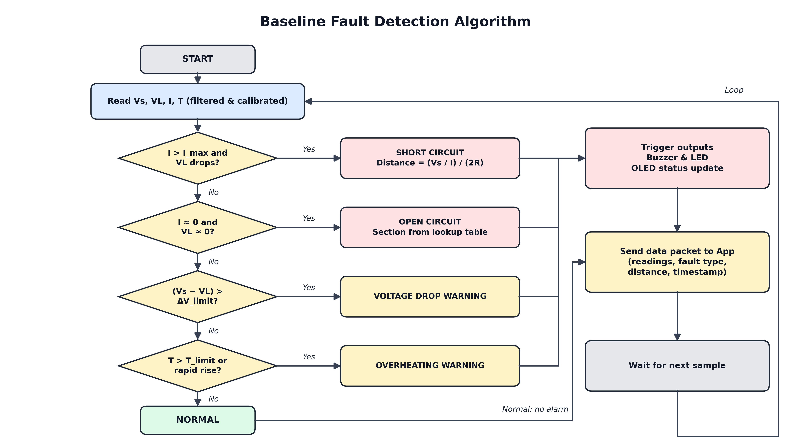
FAULT DETECTION ALGORITHM
KEY POINTS
1
Each cycle reads filtered and calibrated Vs, VL, I and T.
2
Checks run in order: short circuit, open circuit, voltage drop, overheating.
3
Faults trigger the buzzer, LEDs and OLED status update.
4
Every cycle sends a data packet to the app, then waits for the next sample.
Notes:
Explain the decision order and the loop.

Slide 13
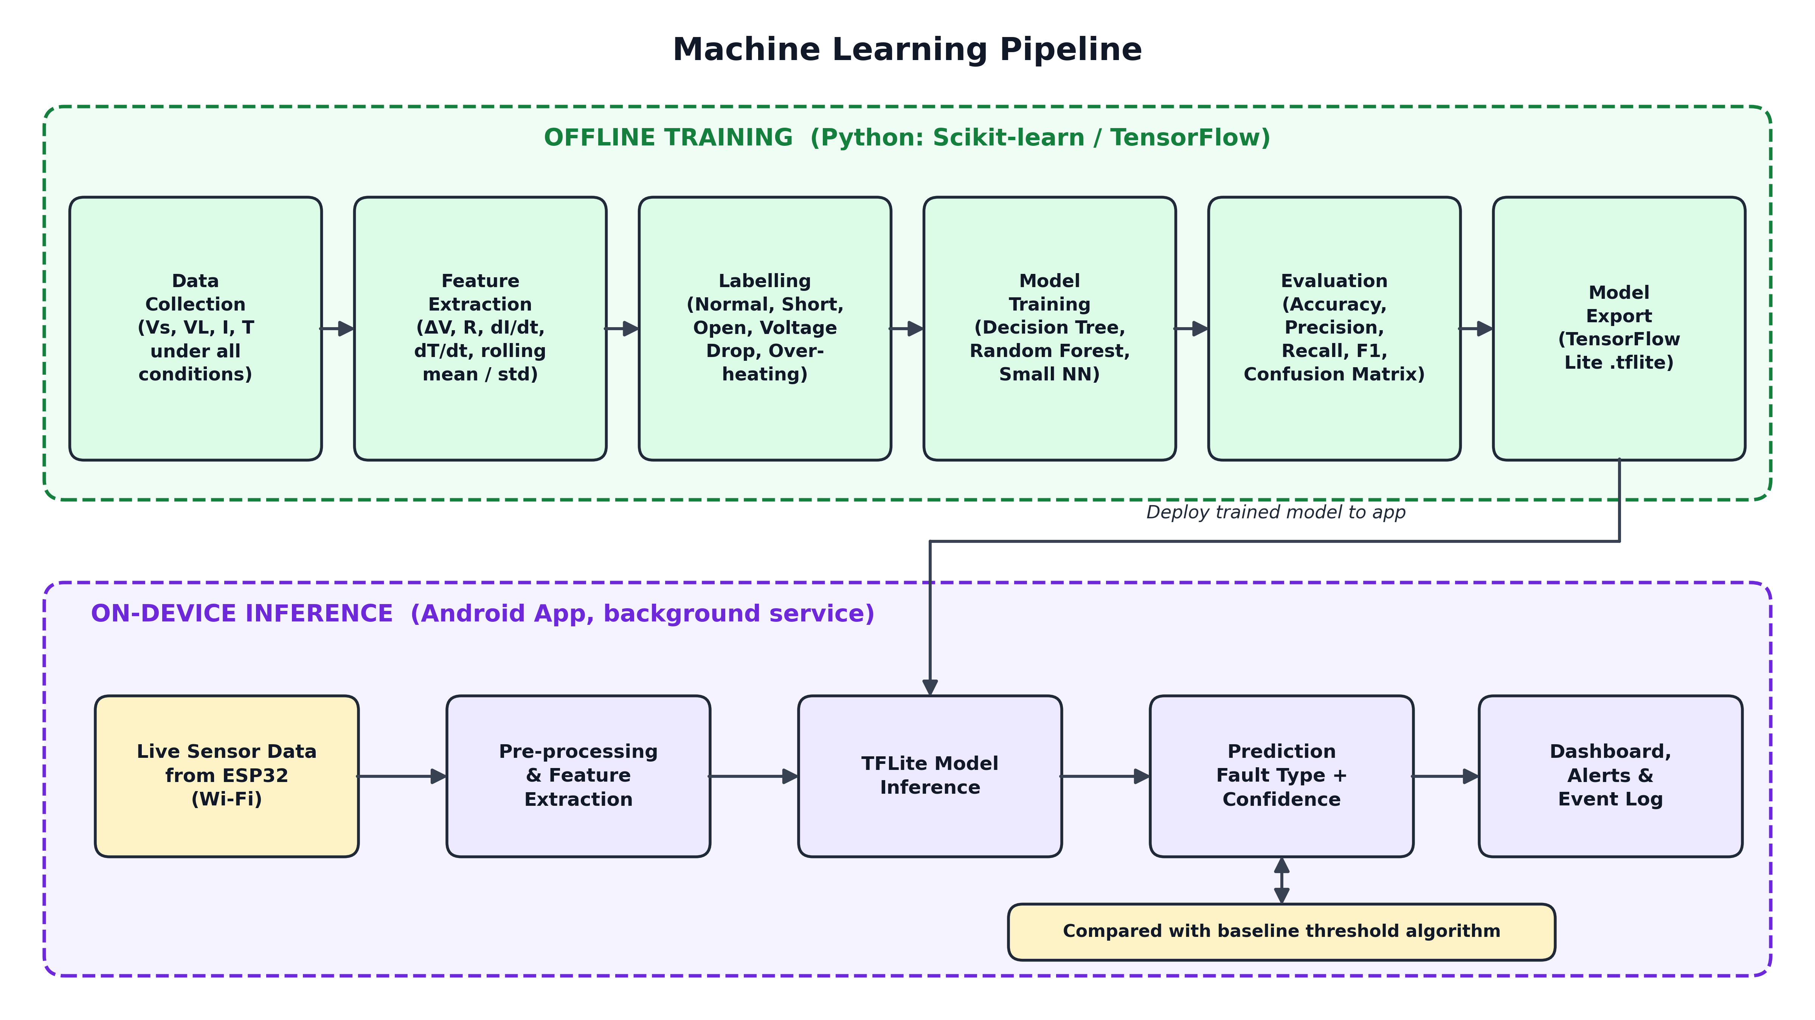
MACHINE LEARNING PIPELINE
KEY POINTS
1
Labelled sensor data is collected under all normal and fault conditions.
2
Features such as ΔV, R, dI/dt and dT/dt train DT, RF and NN models.
3
The best model is evaluated and exported to TensorFlow Lite.
4
The app runs it in the background and compares it with the baseline.
Notes:
Offline training on the PC, inference on the phone.

Slide 14
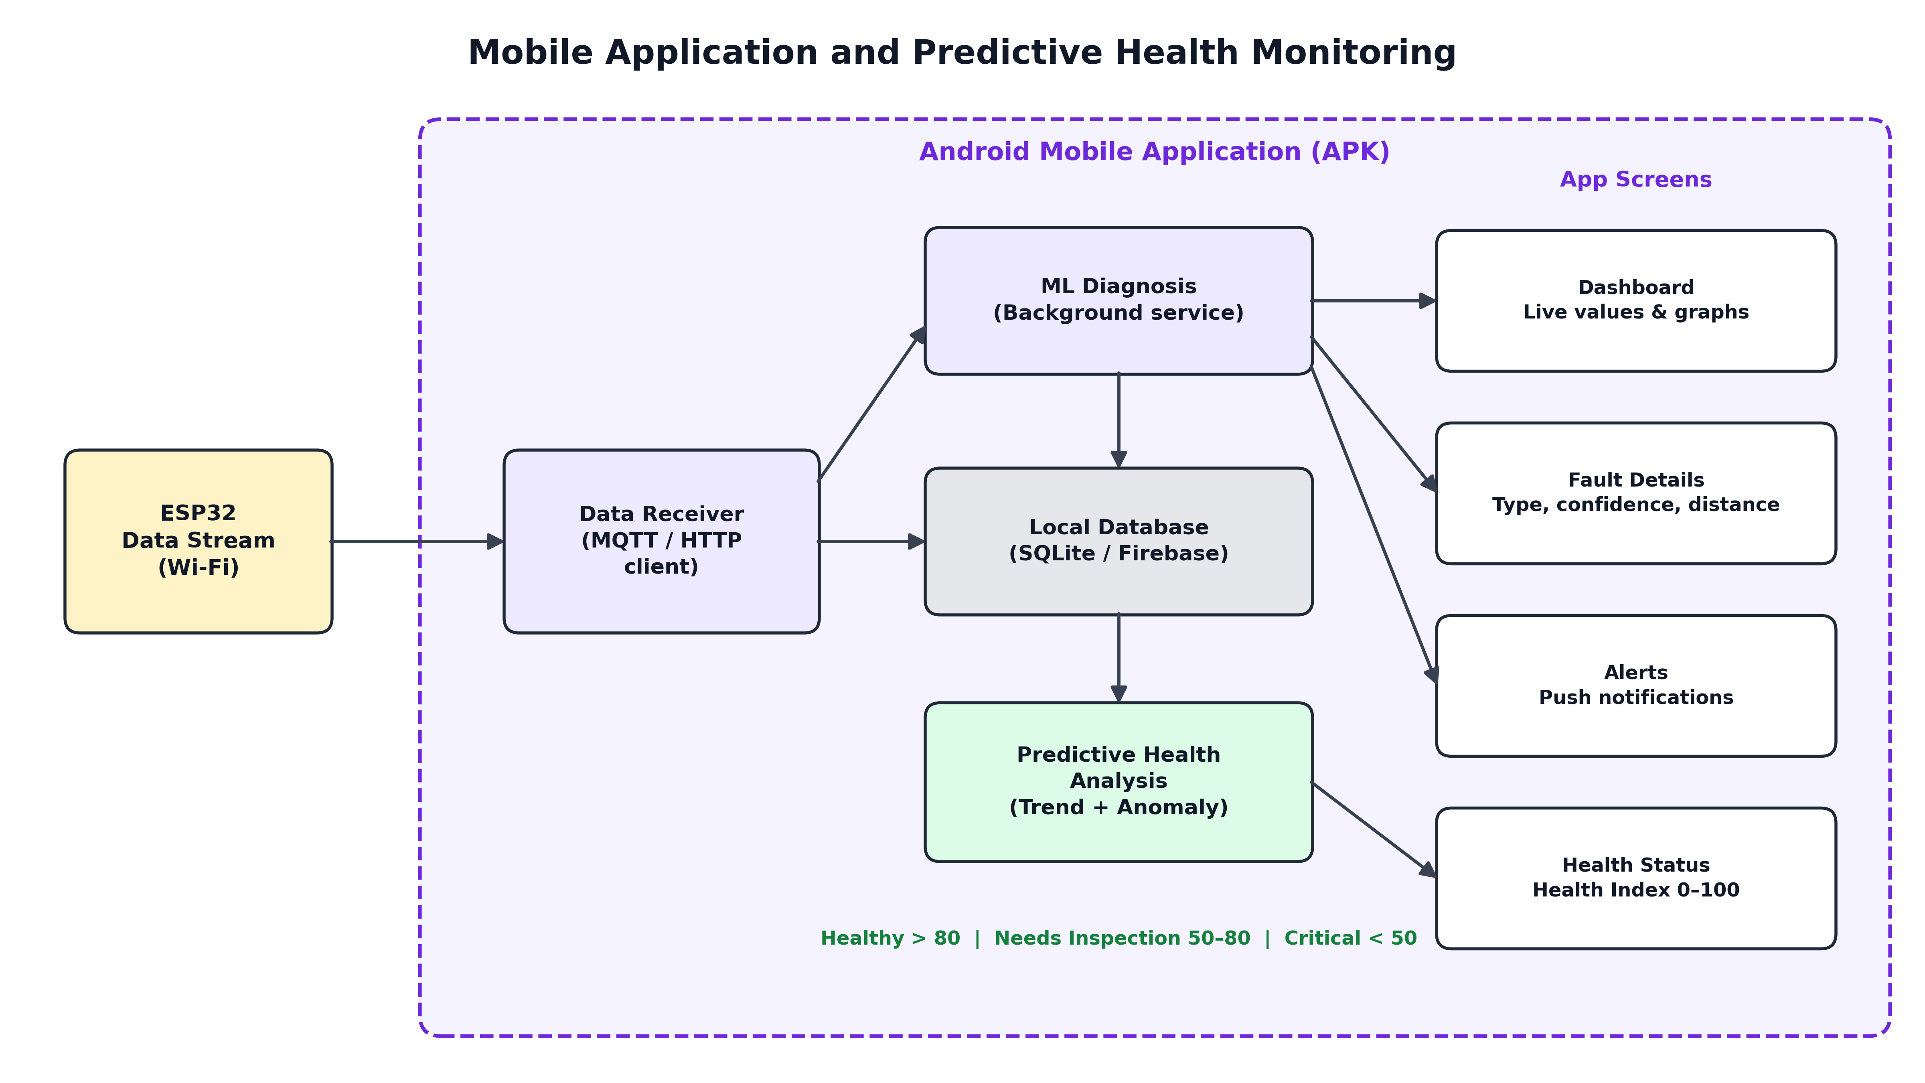
MOBILE APPLICATION
KEY POINTS
1
Data receiver gets ESP32 readings via MQTT / HTTP.
2
ML service predicts the fault type with a confidence score.
3
SQLite stores readings and events for trend analysis.
4
Health index (0–100) and alerts appear on four app screens.
Notes:
Describe the app's internal flow and screens.

Slide 15



LITERATURE SURVEY
[1] S. K. Satyanarayana & S. N. Chandra Shekhar (2024)
Underground Cable Fault Detection Using IoT — IEEE ICCCNT
Arduino, current sensing, ADC, relays, LCD and Wi-Fi cloud storage detect and locate short-circuit faults with remote monitoring.
[2] M. Jayachandran, K. N. Abdul Rani & A. Abd Wahab (2024)
IoT-Based Smart Underground Cable Fault Detector — IEEE ICoCET
Stores fault-zone information in a cloud database for remote access; ML prediction is proposed as future work.
[3] S. Jegadeesan et al. (2026)
ESP32-Driven Fault Detection and Self-Isolating Power Distribution — IEEE ICVADV
ESP32 with V/I sensors classifies faults by thresholds, isolates the faulty section via relays, and reports through GPS and an IoT dashboard.
Notes:
Papers 1 to 3.

Slide 16

LITERATURE SURVEY
[4] K. H. Ali et al. (2022)
Industry Practice Guide for LV Underground Cable Fault-Finding — IEEE Access
Analyses practical techniques and procedures utilities use to pre-locate and pinpoint low-voltage cable faults.
[5] Said et al. (2022)
Deep Learning-Based Fault Classification and Location — IEEE Access
A 1D-CNN with a binary SVM classifies and locates faults in simulated 11 kV underground cables with high accuracy.
[6] Q. Shao et al. (2025)
AI in Cable Fault Detection and Localization — Energies (MDPI)
Reviews ML and deep-learning methods for cable faults and highlights data-scarcity and validation challenges.
Notes:
Papers 4 to 6.

Slide 17
COMPARISON OF EXISTING WORK
Authors | Title | Publication / Year | Methodology | Advantages | Disadvantages
S. K. Satyanarayana & S. N. Chandra Shekhar | Underground Cable Fault Detection Using IoT | IEEE ICCCNT, 2024 | Arduino, current sensing, relay, LCD, Wi-Fi cloud | Low cost; remote monitoring | Short circuits only; no ML
M. Jayachandran et al. | IoT-Based Smart Underground Cable Fault Detector | IEEE ICoCET, 2024 | IoT detector with cloud fault-zone records | Fault history in cloud | ML only proposed
S. Jegadeesan et al. | ESP32-Driven Fault Detection and Self-Isolating Framework | IEEE ICVADV, 2026 | ESP32, V/I sensors, relays, GPS, IoT dashboard | Auto isolation; real-time | Threshold-based; no temperature
K. H. Ali et al. | Industry Practice Guide for LV Cable Fault-Finding | IEEE Access, 2022 | Analysis of field fault-finding procedures | Practical industry guidance | Manual; not automated
Said et al. | Deep Learning-Based Fault Classification and Location | IEEE Access, 2022 | 1D-CNN + binary SVM | High accuracy | Simulation; heavy compute
Q. Shao et al. | AI in Cable Fault Detection and Localization | Energies (MDPI), 2025 | Review of ML and DL methods | Broad AI overview | No hardware
Notes:
Side-by-side comparison of the six papers.

Slide 18

REFERENCES
[1] S. K. Satyanarayana and S. N. Chandra Shekhar, “Underground Cable Fault Detection Using IoT,” IEEE ICCCNT, 2024. doi:10.1109/ICCCNT61001.2024.10726118
[2] M. Jayachandran, K. N. Abdul Rani and A. Abd Wahab, “IoT-Based Smart Underground Cable Fault Detector,” IEEE ICoCET, 2024. doi:10.1109/ICoCET63343.2024.10730067
[3] S. Jegadeesan et al., “An Intelligent ESP32-Driven Underground Cable Fault Detection and Self-Isolating Power Distribution Framework,” IEEE ICVADV, 2026. doi:10.1109/ICVADV67766.2026.11470434
[4] K. H. Ali, A. A. Aboushady, S. Bradley, M. E. Farrag and S. A. Abdel Maksoud, “An Industry Practice Guide for Underground Cable Fault-Finding in the Low Voltage Distribution Network,” IEEE Access, 2022. doi:10.1109/ACCESS.2022.3186352
[5] Said et al., “Deep Learning-Based Fault Classification and Location for Underground Power Cable of Nuclear Facilities,” IEEE Access, 2022. ieeexplore.ieee.org/document/9810250
[6] Q. Shao, S. Fan, Z. Zhang, F. Liu, Z. Fu, P. Lv and Z. Mu, “Artificial Intelligence in Cable Fault Detection and Localization: Recent Advances and Research Challenges,” Energies, 2025. doi:10.3390/en18143662
Notes:
Full references with DOIs.

Slide 19

THANK YOU
Questions and suggestions are welcome
Deta Jonah Ratan • Madavaram Vineel • Pasnoori Abhinay
Guide: Ms. A. Swapna, Asst. Professor, Dept. of ET, MGIT
Notes:
Thank the panel and invite questions.

